Slide 1
Exploit Buffer Overflow Vulnerability
Presented by
Bhavi Tarun Chintala
Reg no : 11602305
Roll no : A22
Section : RKEM66
Submitted to
Ravi Shankar sir

Slide 2
WHAT IS A BUFFER OVERFLOW?
A buffer overflow, or buffer overrun, is a common software coding mistake that an attacker could exploit to gain access to your system. To effectively mitigate buffer overflow vulnerabilities, it is important to understand what buffer overflows are, what dangers they pose to your applications, and what techniques attackers use to successfully exploit these vulnerabilities

Slide 3
Key Concepts of Buffer Overflow
This error occurs when there is more data in a buffer than it can handle, causing data to overflow into adjacent storage.
This vulnerability can cause a system crash or, worse, create an entry point for a cyberattack.
C and C++ are more susceptible to buffer overflow.
Secure development practices should include regular testing to detect and fix buffer overflows. These practices include automatic protection at the language level and bounds-checking at run-time

Slide 4
Definition of a Buffer Overflow
A buffer is a sequential section of memory allocated to contain anything from a character string to an array of integers. A buffer overflow, or buffer overrun, occurs when more data is put into a fixed-length buffer than the buffer can handle. The extra information, which has to go somewhere, can overflow into adjacent memory space, corrupting or overwriting the data held in that space. This overflow usually results in a system crash, but it also creates the opportunity for an attacker to run arbitrary code or manipulate the coding errors to prompt malicious actions.

Slide 5
Many programming languages are prone to buffer overflow attacks. However, the extent of such attacks varies depending on the language used to write the vulnerable program. For instance, code written in Perl and JavaScript is generally not susceptible to buffer overflows. However, a buffer overflow in a program written in C, C++, Fortran or Assembly could allow the attacker to fully compromise the targeted system.

Slide 6
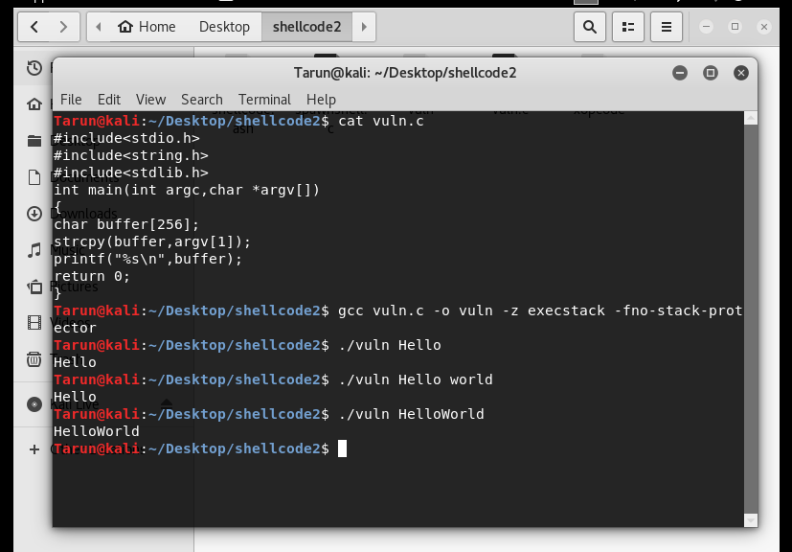

Slide 7
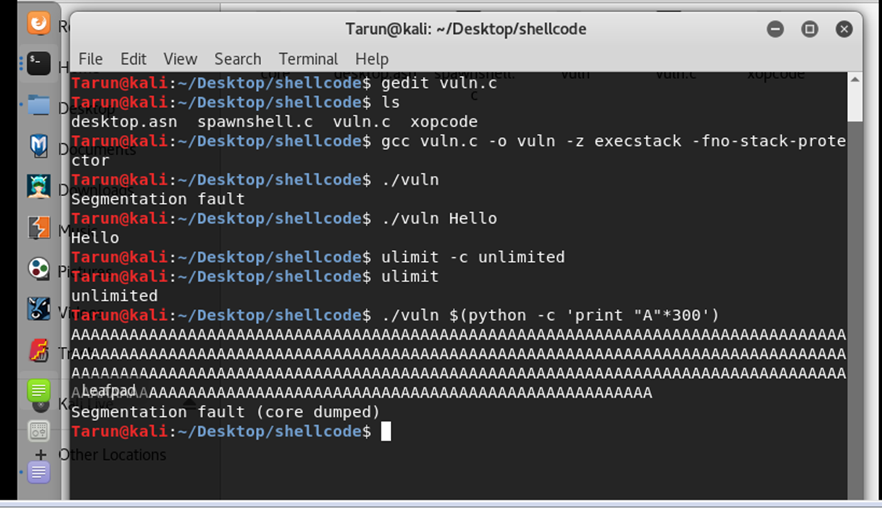

Slide 8
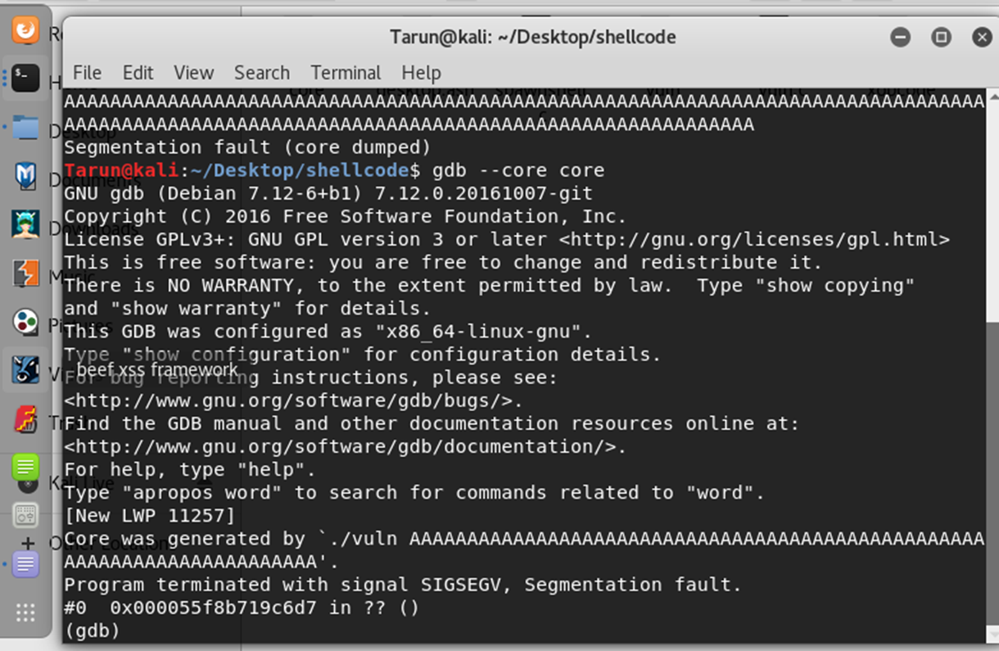

Slide 9
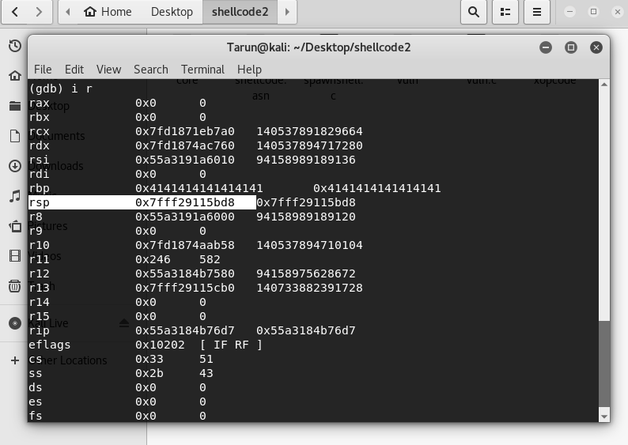

Slide 10
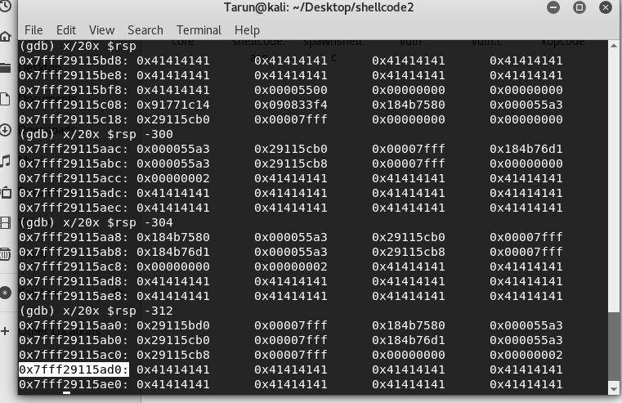

Slide 11
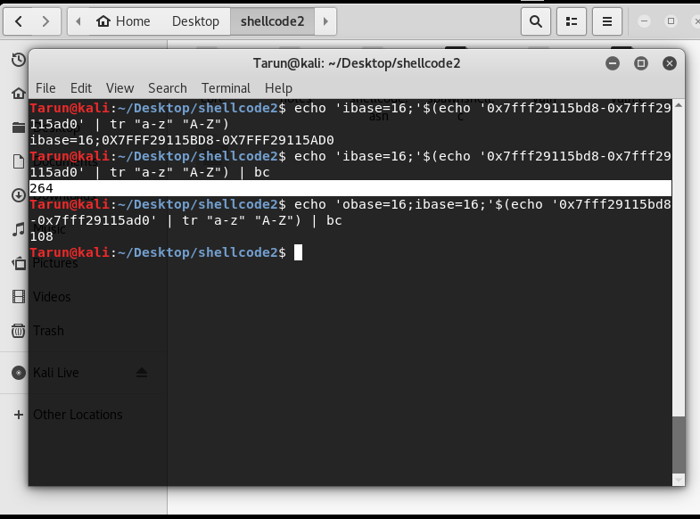

Slide 12
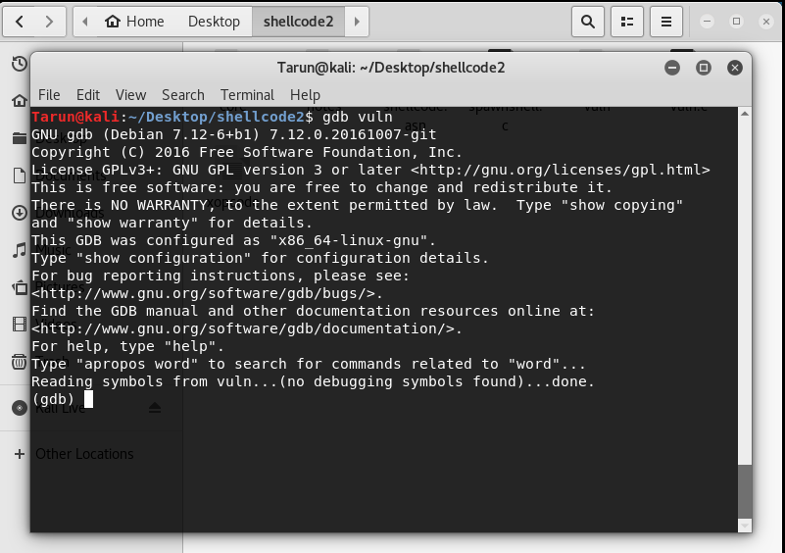

Slide 13
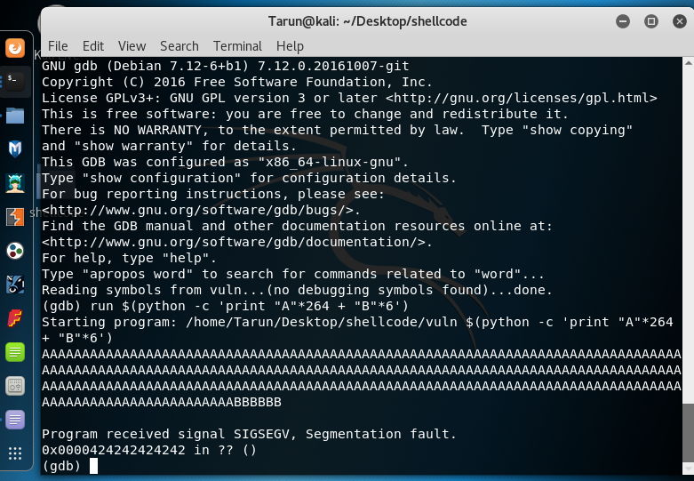

Slide 14
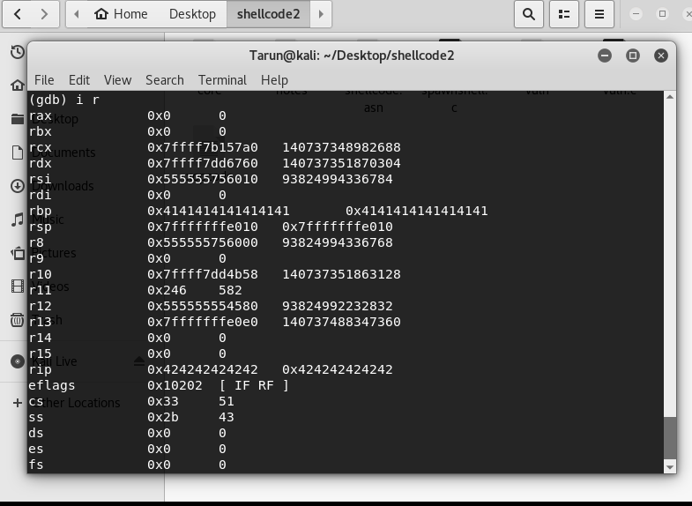

Slide 15
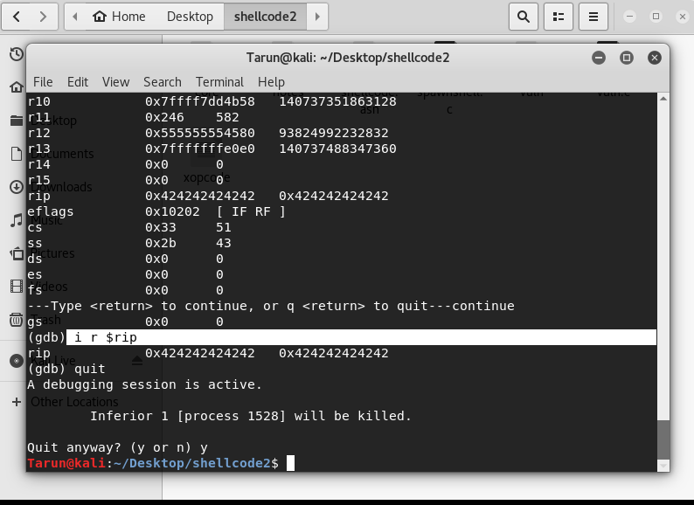

Slide 16
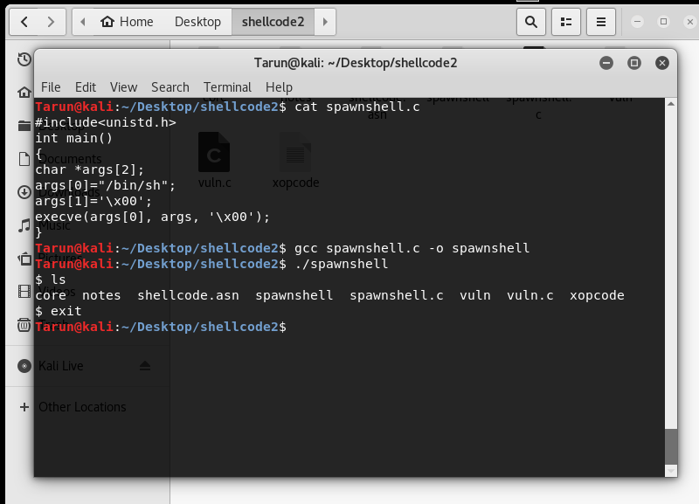

Slide 17
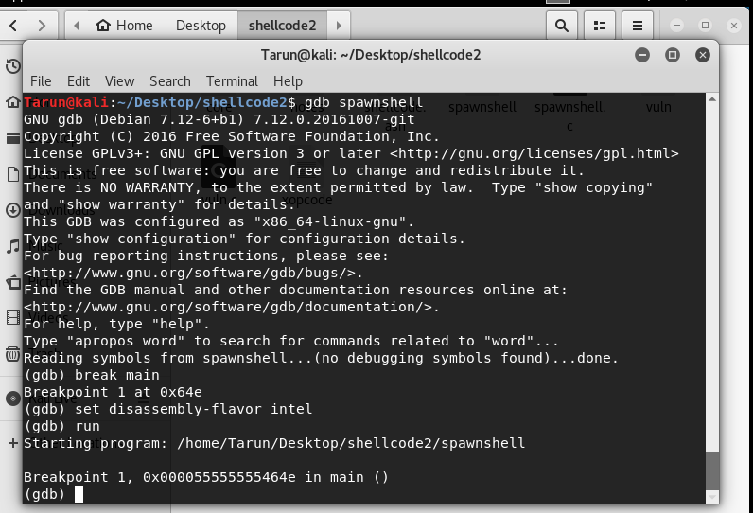

Slide 18
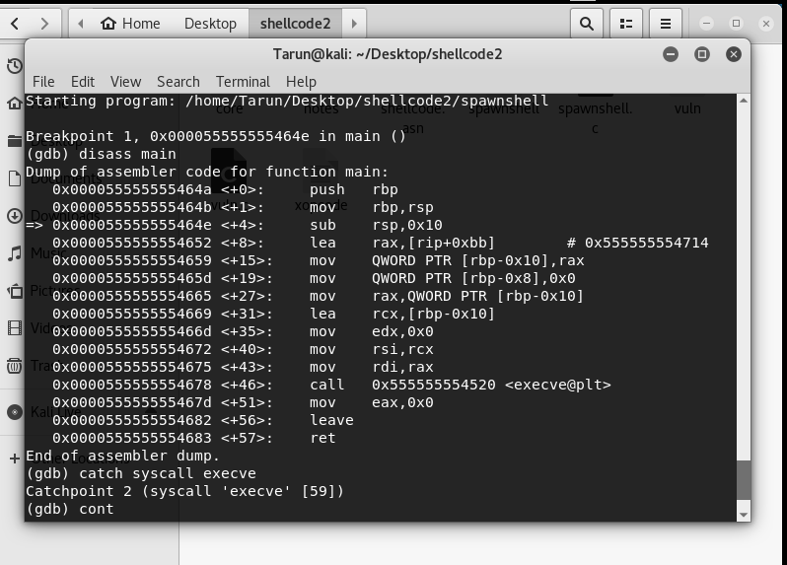

Slide 19
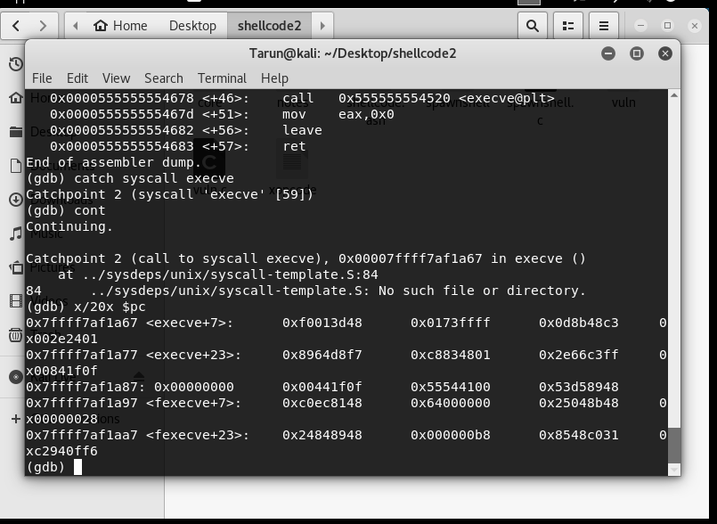

Slide 20
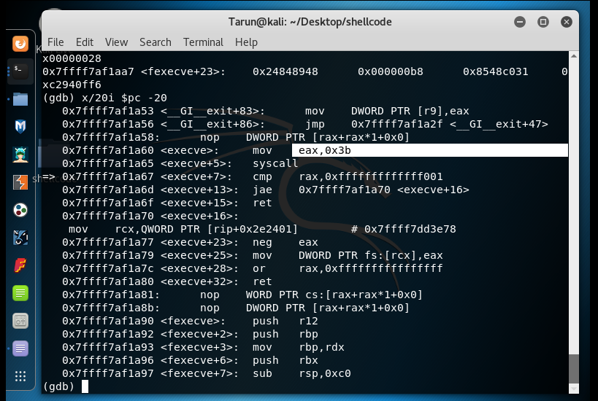

Slide 21
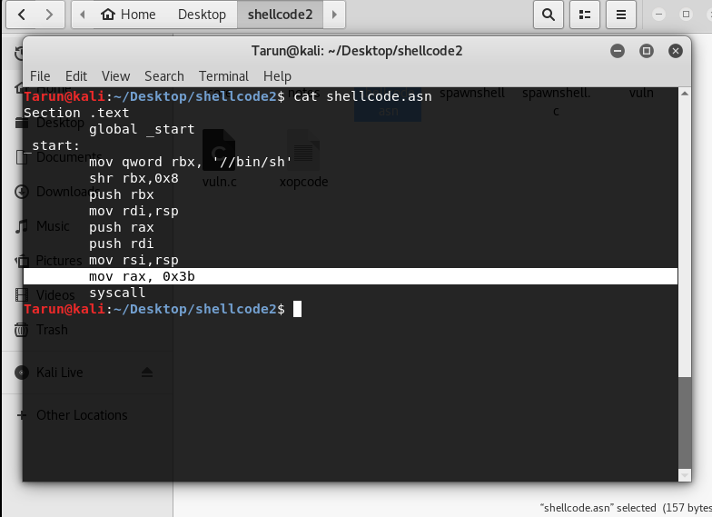

Slide 22
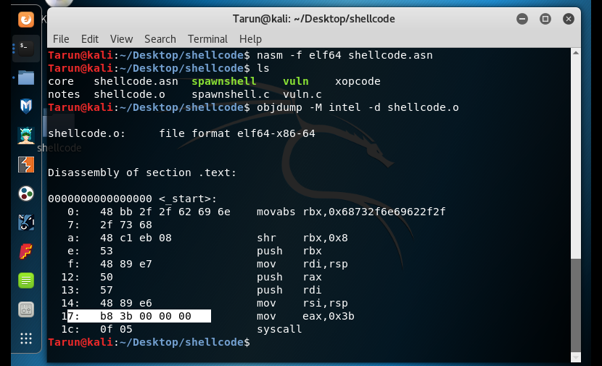

Slide 23
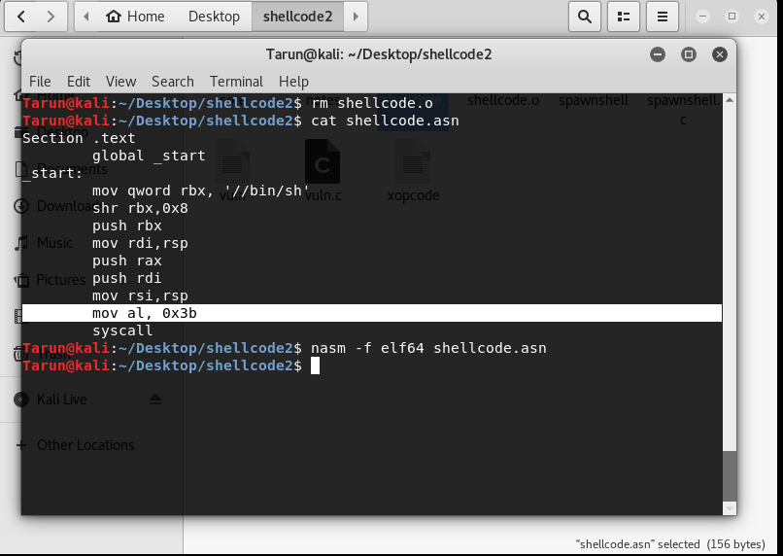

Slide 24
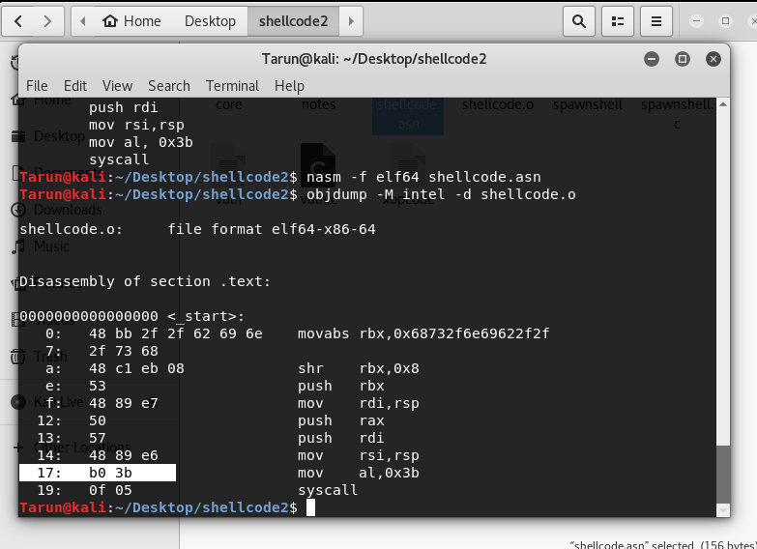

Slide 25
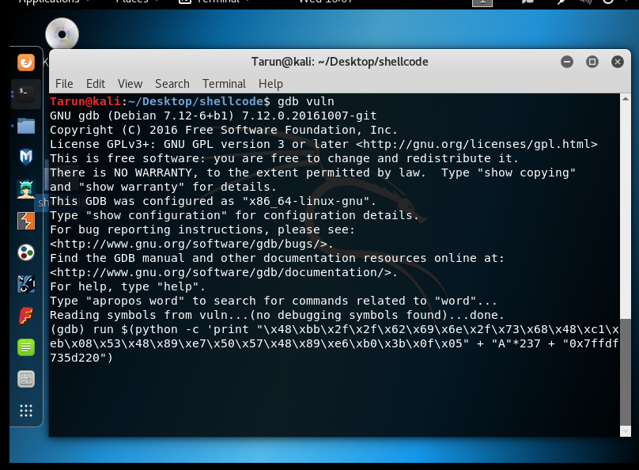

Slide 26
Execute the following commands one after another
run $(python –c ‘print “A”*27 + “A”*237 + “B”*6’)
x/20x $rsp -300
x/20x $rsp -304
I got correct match of address at x/20x $rsp -304
That is 7fffffffdef0
I used this address in next step at the end of the command as \x7f\xff\xff\xff\xde\xf0

Slide 27
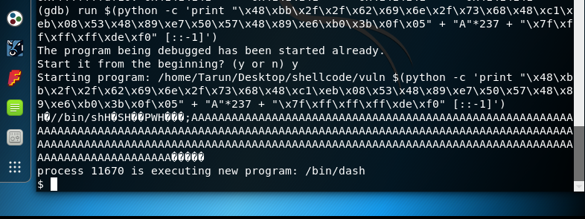

Slide 28
In the above slide you can observe, at the end of the string it is showing some random values which means due to exceeding allocated memory space buffer overflows.

Slide 29
The End

